Slide 1
Agentic AI Hackathon: Building Intelligent Agents with IBM Granite and LangFlow

Slide 2



Name of the team: Team Phoenix
Details of Team members
TEAM MEMBER NAME | Recent Passport Photo | Email ID | Phone number [WhatsApp]
Goutham Siddalingappa Chavadi |  | gouthamsc2@gmail.com | +91 90197 95403
Aishwarya S S |  | aishwaryass1902@gmail.com | +91 97313 84044
Mohit Niranjan |  | mohitn2004@gmail.com | +91 72592 55946

Slide 3
Problem statement
The Challenge
Traffic congestion hotspots often develop gradually due to increasing demand, roadworks, or external disruptions. Existing traffic systems lack early warning mechanisms that identify congestion trends before they escalate. An intelligent system is required to continuously monitor traffic data and flag potential congestion of hotspots in advance.
Traffic Data Analysis Agent
An agent that processes vehicle speed, traffic density, travel time, and external factors such as weather or incidents.
Congestion Risk Detection Agent
An agent that detects early signs of congestion by analyzing deviations from historical and seasonal traffic trends.
Alert & Planning Assistant
An agent that issues early warnings and provides planning-level advisories for traffic authorities (assistive only).

Slide 4
Proposed solution
AI-Driven Early Warning System for Traffic Congestion Hotspots
Continuously analyzes real-time and historical traffic data
Detects early congestion trends before gridlock occurs
Generates risk scores for traffic hotspots
Issues proactive alerts and planning advisories to authorities
Supports data-driven, preventive traffic management

Slide 5
Need of project
Traffic congestion builds gradually, not instantly
Existing systems react after congestion forms
Lack of predictive insights causes:
Increased fuel loss
Emergency response delays
Urban productivity loss
Cities need early warning intelligence, not just monitoring.
Prevention is cheaper and smarter than cure

Slide 6
End user of project
Traffic Control & Transport Authorities
Smart City Operation Centers
Urban Planning Departments
Emergency Response Teams
City Policy Makers & Infrastructure Planners
Assistive system — supports decisions, not replaces humans

Slide 7
Technology Used
Langflow – Visual multi-agent orchestration
Langflow component name – Agent , Chat input , Chat output
IBM Granite model - ibm-granite-3-2-8b
IBM Cloud
IBM watsonx.ai (Granite Models) – AI reasoning & insights
RAG (Retrieval Augmented Generation)
Search API – External traffic & contextual data

Slide 8
Novelty and Uniqueness
Early-stage congestion prediction (not post-event analysis)
Multi-agent intelligence with clear role separation
Combines:
Historical trends
Seasonal patterns
External disruptions
AI-assisted planning advisories (not black-box outputs)
Low-cost, scalable design suitable for smart cities

Slide 9
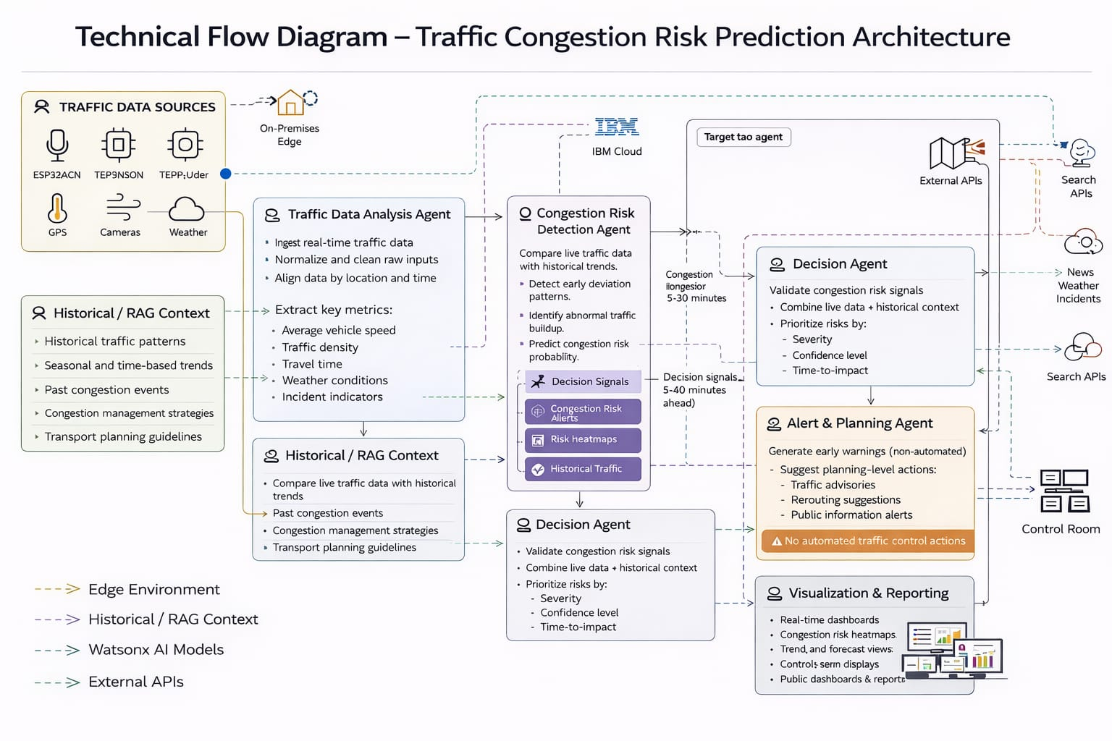
Technical flow diagram - Architecture blueprint

Slide 10
Langflow component Used
Chat Input - Accepts user queries
IBM watsonx AI Agent (Multiple Agents) -Traffic Analysis, Congestion Risk Detection, Decision, Alert & Planning ,Visualization
Search API Tool -Fetches real-time traffic, weather, and incident data
File Component (RAG / Historical Context) -Provides historical traffic patterns and guidelines
Chat Output - Displays alerts, predictions, and recommendations

Slide 11
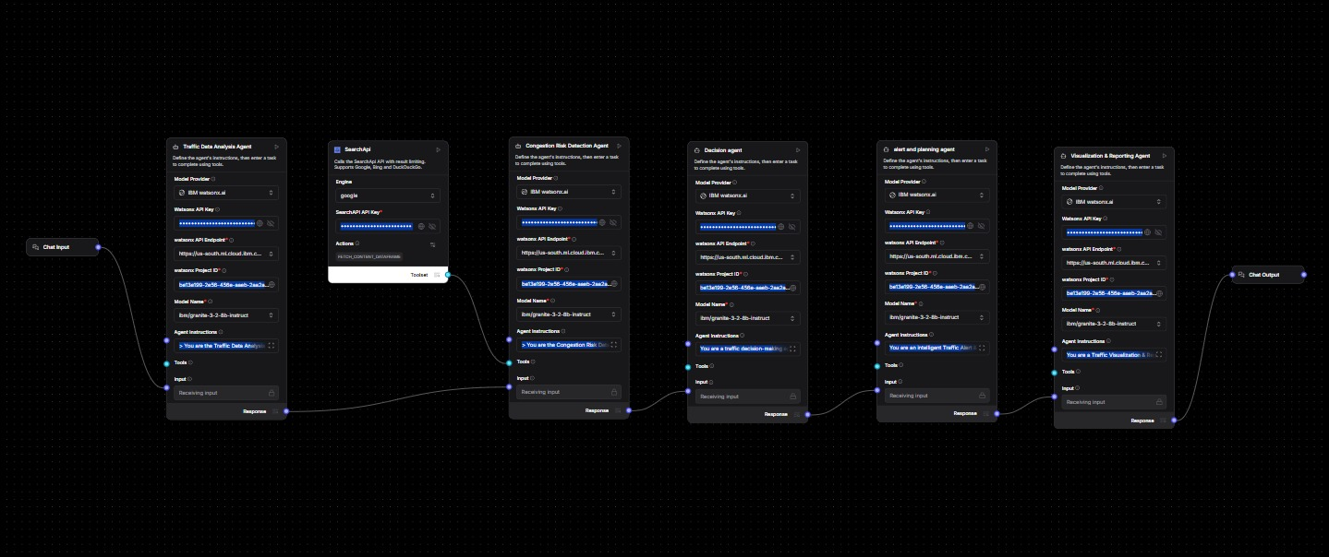
Input Screenshot 1

Slide 12
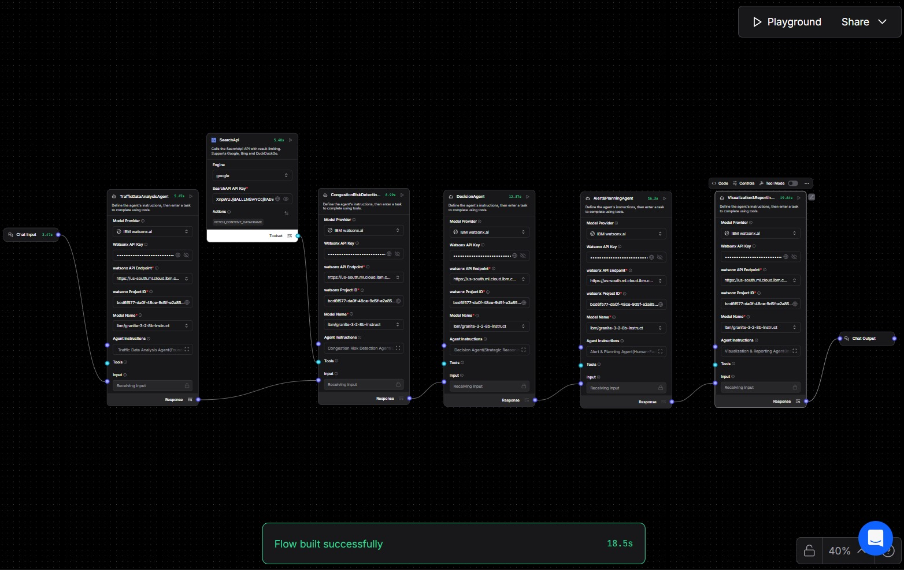
Input Screenshot 2

Slide 13
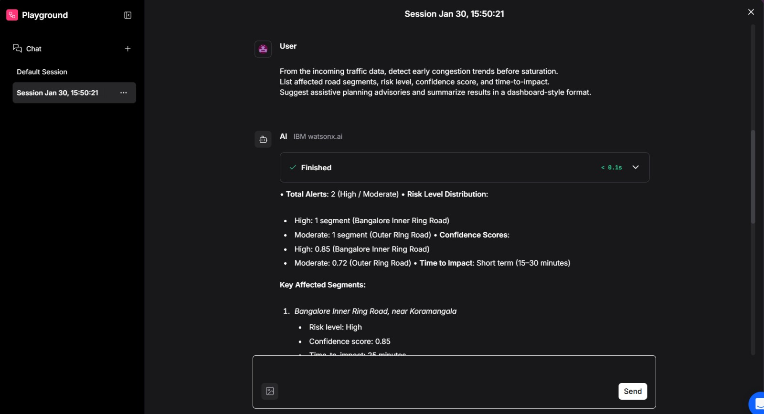
Output Screenshot 1

Slide 14
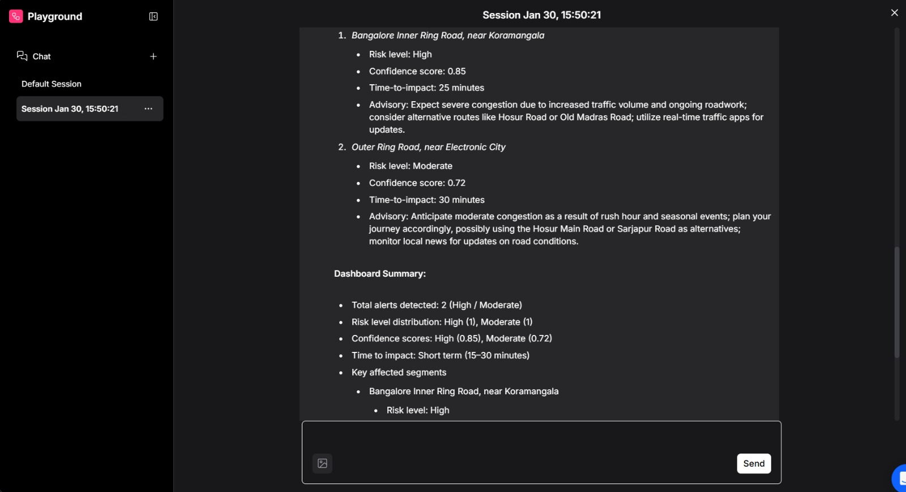
Output Screenshot 2

Slide 15
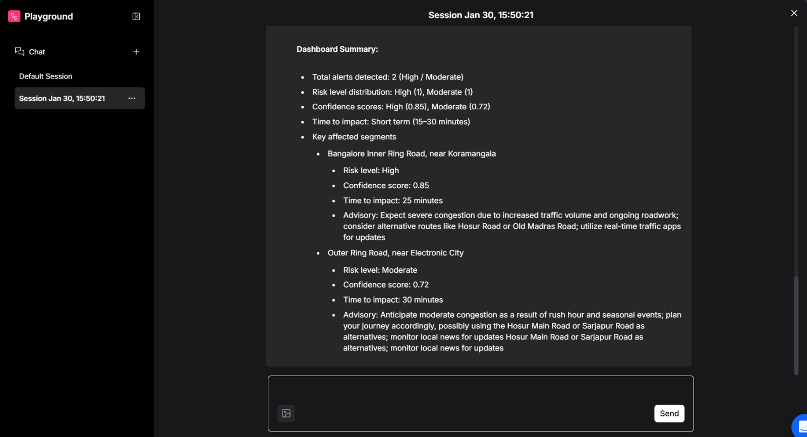
Output Screenshot 3

Slide 16
Future Scope
Scaling Toward Intelligent Urban Mobility
Adaptive Traffic Signal Automation
AI-driven signal timing based on predicted congestion risk.
Real-Time IoT & GPS Integration
Live traffic sensors, cameras, and navigation data ingestion.
Predictive Heatmaps & Dashboards
Visual congestion forecasting for planners and control rooms.
Emergency & Incident Intelligence
Faster routing and priority signaling for emergency vehicles.
Multi-City Smart Deployment
Scalable rollout across cities with shared learning models.
·

Slide 17
Git Hub Link
https://github.com/goutham-debug/AI-Driven-Early-Warning-System-for-Traffic-Congestion-Hotspots

Slide 18
References
IBM watsonx.ai Documentation
Langflow Official Documentation
Urban Transport Planning Guidelines

Slide 19


